Slide 1

Community Services Portable Long Service Leave Scheme
October 2020

Slide 2
Background
Broad stakeholder consultation & Taskforce formed
Legislation passed
Palaszczuk Govt commits
to investigate CSI scheme
Govt announces intention to introduce scheme
2017
2018
2019
2020
Notes:
In 2017, the Palasczuk Government committed to investigate the feasibility of a Community Services long service leave scheme after lobbying from the Services and Workers Unions.
The Office of Industrial Relations released a Consultation Regulatory Impact Statement in September 2018 to consult with industry stakeholders, including employer organisations, employee organisations, peak industry bodies and service providers.
The consultation process indicated broad in-principle support for a scheme. In response the Minister established the PLSL Community Services Sector Stakeholder Taskforce. The taskforce sought input from stakeholders in ACT and Victoria on their experience. ACT scheme started in 2010 and Victorian scheme in 2019.
Consultation on the proposed scheme and Bill was also conducted with relevant government agencies. The Bill was first put to Parliament in 2019. The Act was assented on 22 June 2020.
Current status – awaiting for regulations, commencement date and Board members to be approved by Governor-in-Council. Hoping this will occur on 3rd September so all details can be formalised and announced shortly after this date.

Slide 3
About QLeave
Established in 1992 for building and construction
Contract cleaning industry commenced in 2005
Each scheme administered in accordance with governing legislation
Three separate boards who report to the Minister – each board has a chair and deputy chair then directors who represent both employers and workers in the sector
Notes:
QLeave was established on 1 July 1992 by the Queensland Government to provide portable long service leave benefits for the state’s building and construction industry. We were established in response to decades of campaigning by industry bodies, unions and workers, who until 1992 were often disadvantaged as the nature of their work meant they were unlikely to be employed in the continuous service needed to earn long service leave.
On 1 July 2005 we also started providing a similar scheme for Queensland’s contract cleaning industry.
On 1 January 2021, we will provide a portable long service leave scheme for Queensland's community services industry.
Each scheme is administered in accordance with its governing legislation, and we're governed by three individual boards who each report to the Minister.

Slide 4




Portable long service leave coverage
Construction industry
Cleaning industry
Community sector
Security industry
Notes:
Shows scheme coverage across Australia

Slide 5

Scheme objective
Provide workers with access to a long service leave entitlement in an industry:
  characterised by high insecurity and high mobility
  where the work is reliant on recurrent rounds of funding
  where retaining skilled and experienced workers is essential
  so that they can continue to provide care for vulnerable members of our society.
Notes:
ABS data shows that nearly one-in-four workers do not receive any paid leave entitlements
25% of workers engaged for <12 months
It is estimated that there are over 50,000 workers in Queensland who are likely to be covered by the scheme but it could be many more.
The profile of the paid workforce in the Community Services Industry differs markedly to the Queensland workforce as a whole:
75.4% of employees are female, compared to 47.1% of the overall Queensland workforce;
50.2% of employees work part-time, compared to 32.5% of the overall Queensland workforce; and
the largest share of the paid workforce in the Community Services Industry in Queensland is between the age of 45 and 54 years, in contrast to the overall Queensland workforce having a much flatter workforce distribution of workers between the ages of 20 and 54 years.
The paid workforce is highly skilled; with 66.9% of paid Community Services Industry workers in Queensland holding a post-school qualification compared to 58.8% in the overall Queensland workforce.

Slide 6
Stakeholder Taskforce
Represented peak bodies and unions including:
  The Services Union
  Community Legal Centres Queensland
  QCOSS
  The Community Services Industry Alliance
  The Australian Workers’ Union
  National Disability Services United Workers Union
  Queensland Council of unions
Reached consensus on the scheme including broad coverage of workers, no recognition of retrospective service, access to leave after seven years service, starting levy rate based on actuarial assessment (1.35%)
Notes:
As mentioned, the Office of Industrial Relations established a taskforce to assist with the details of the legislation. The purpose of the taskforce was to reach consensus across industry on a number of elements of the scheme. The value of consulting in this way is that all parts of the industry are recognised – workers are represented by the Unions and employer associations are represented by peak bodies.
The taskforce determined:
That the scheme would have broad coverage and include a range of workers – even those in support roles who are not necessarily delivering community services
That there would be no recognition of retrospective service like there are in the other schemes
That due to the range of EBAs currently available to specifically NFP workers – they scheme would provide for access to long service leave after seven years of service (2,555 service credits)
The levy would be determined by an actuarial assessment – the starting levy rate is 1.35%

Slide 7
About the scheme – what you need to know
An employer must provide community services (whether it is all or part of its operations) for their workers to be registered.
Starts 1 January 2021. First employer return and levy payment due 14 April 2021 (for the 1 January 2021 – 31 March 2021 quarter). Employers report the ordinary wages they have paid to their workers. They will then pay a levy, of 1.35%, on those wages.
These levies collected are invested and the accumulated funds are used to pay the workers’ long service leave claims.
When a worker has recorded seven years of service with QLeave, they are entitled to 6.1 weeks of paid long service leave.

Slide 8
About the scheme – who is eligible?
Workers in Queensland’s community services industry who:
perform community services work, or
support the provision of community services.
This includes workers who:
are full-time, part-time or casual
are engaged under a contract for service, including labour hire workers that operate as a sole trader
work for both for-profit and not-for-profit organisations.

Slide 9
About the scheme – who is not eligible?
Some community service workers are not eligible to join QLeave, including:
federal, state and local government workers
workers who perform work that’s not related to the purpose of providing community services
workers in standalone childcare and early childhood education centres, kindergartens and school-based childcare services
workers employed in aged care, in a nursing home or retirement village delivered by a standalone aged care provider or service.

Slide 10
Scenario 1
A worker who works with one employer before and after the scheme is introduced -
2019
Jenny continues working with ABC
2028
2029
Jenny starts working with ABC
2021:
all eligible workers registered with QLeave
Jenny is eligible for PLSL
(7 years and 2,555 service days recorded with QLeave)
Jenny is eligible for LSL
(10 years) under Industrial Relations Act 2016

Slide 11
Scenario 2
A worker who works with multiple employers before and after the scheme is introduced -
2018
Dave continues working with XYZ
2022
2023
Dave continues working with ABC
2029
Dave starts working with XYZ
2021:
all eligible workers registered with QLeave
Dave leaves XYZ and has a 1 year break
Dave starts with ABC
Dave is eligible for PLSL
(7 years in the scheme)

Slide 12
Scenario 3
A worker who works with the same employer before and after the scheme is introduced -
2012
Clare continues working with MNO
2022
Clare starts working with MNO
2021:
all eligible workers registered with QLeave
Clare is eligible for LSL
(10 years) under the Industrial Relations Act 2016
MNO pay Clare her long service leave.
MNO claim reimbursement for the leave accrued with QLeave since 1 Jan 2021

Slide 13
Scenario 4
A worker who works with the same employer (with a more beneficial EBA) before and after the scheme is introduced -
2018
Peter continues working with RST
2023
Peter starts working with RST
2021:
all eligible workers registered with QLeave
Peter is eligible for 5 years’ LSL with RST’s benefits
RST pay Peter his long service leave.
RST claim reimbursement for the leave accrued with QLeave since 1 Jan 2021

Slide 14




Four phases of engagement
04
03
02
01
Compliance
Support
Educate workers about managing their membership.
Employers are compliant with their obligations
Education
Building knowledge of the return and levy process = Employers are supported to complete their quarterly returns
Awareness
Building knowledge of the scheme =
Employers understand their obligations
Create awareness of the scheme
Notes:
Working in partnership with industry
Using existing industry channels and networks
Engagement channels through Board members
Digital engagement during COVID-19 and beyond
We currently partner with industry associations, employer groups, peak bodies and other stakeholders to maximise awareness of our schemes.
In contrast to the other industries we serve, Community Services has an extensive range of existing channels and networks which presents many new opportunities for engagement. Our aim is to continue this way of working by partnering with all stakeholders to distribute information and maximise our reach across the state.
We intend to work closely with our Board members to support information sharing and ensure the workers and employers are aware of the scheme and their legislative obligations.
We will look to use digital engagement tools to deliver content to stakeholders as we adapt to changing COVID-19 restrictions.

Slide 15
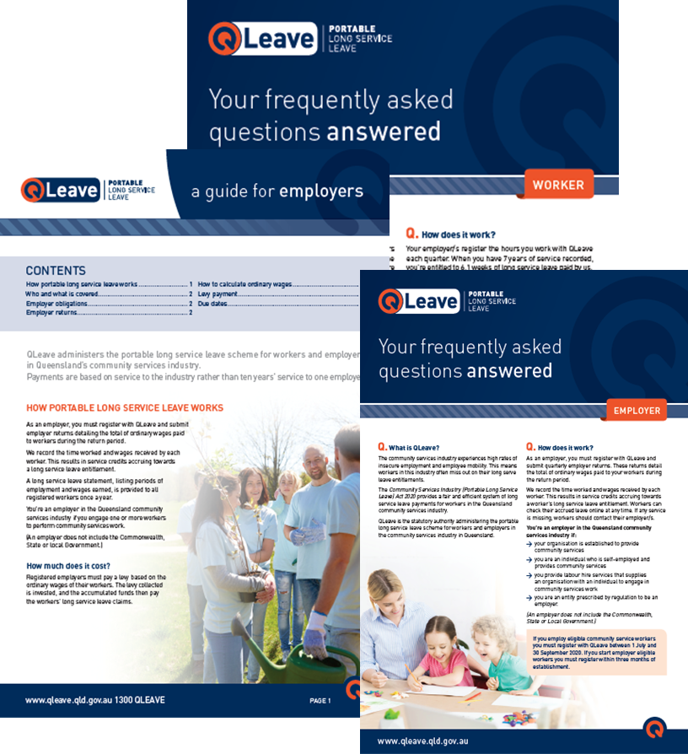
Information and resources
Website
  Primary information source
  Legislative information
  Registration for employers and workers
  All transactions available online
Resources
  Worker FAQs
  Employer FAQs
  Guides and printable resources
  Phone lines and chat bot available
Notes:
To support our building and construction and contract cleaning industries we have a range of existing communication channels and collateral.
Our website www.qleave.qld.gov.au is the primary source of scheme content for all workers and employers. We have dedicated community services section on the site.
A series of videos will be launched to the site shortly.
Stakeholders can already register their interest with the scheme, through this site. We will use this ‘mailing list’ to send electronic direct mail with updates, important content and other useful information prior to the scheme coming in to effect.
Once the scheme is up and running, all transactions will occur through the website.
Our phone lines and chat bot are now set up to support community services enquiries.

