Slide 1

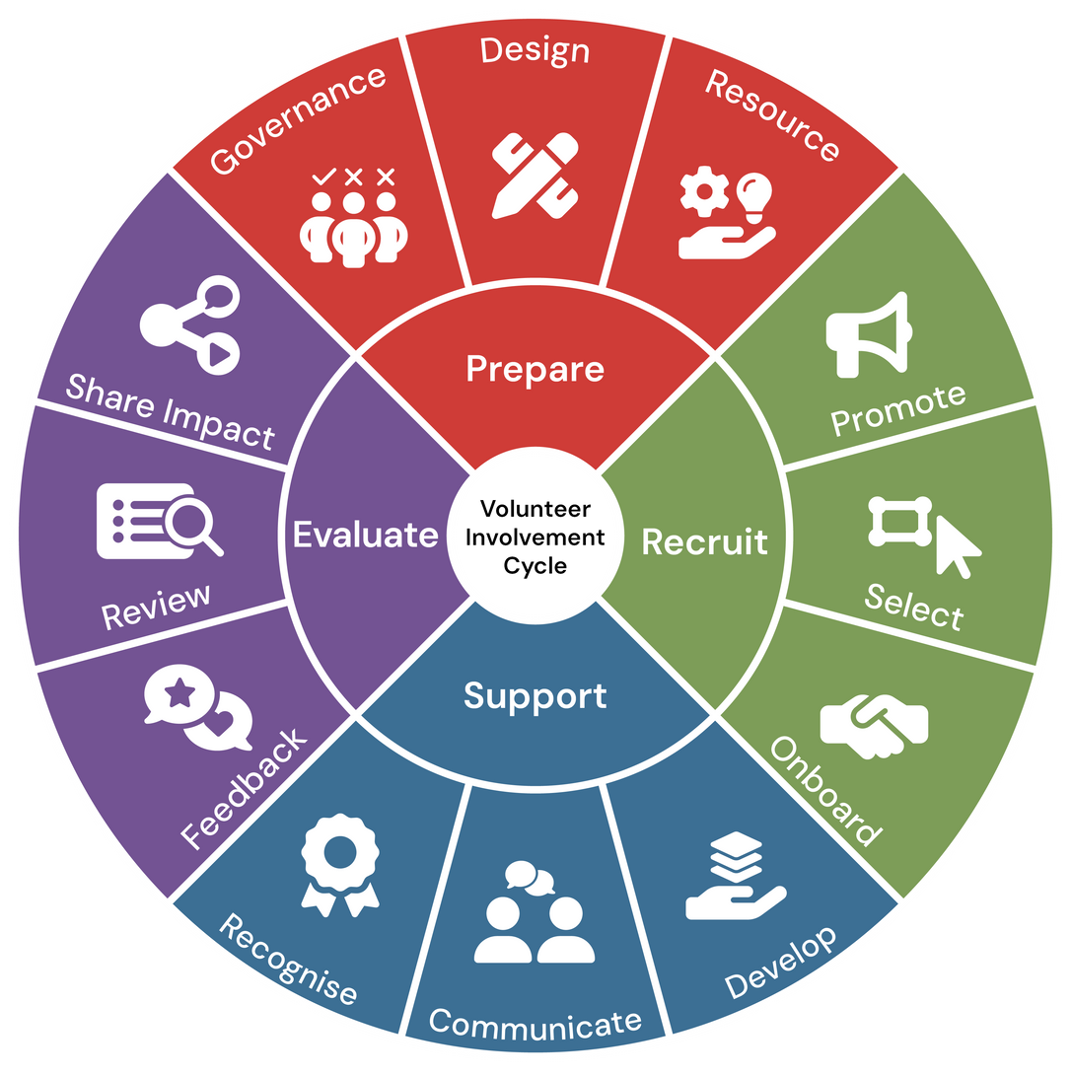

Module 1:
PREPARE
Volunteer Involving Organisations:
Volunteer Involvement Cycle Review Workshop

Slide 2





Facilitation
The training can be completed with a facilitator in 4x 2hour session. As there are a number of data sets that need to be gathered- preparation is key to utilise the full benefit of these workshops
Independant
Resource
Instructions
The resouce can be utilised independantly at your own pace.
Resources
All resources relating to this review module can be found HERE and should be downloaded and reviewd before beggining each module
Help
SHould you require help please contact us at Info@seniors.org.au

Slide 3
Introduction &
Objectives

Slide 4



Objectives
Guide Volunteer-Involving Organisations (VIOs) through a structured review of their volunteer involvement cycle management practices.
Support the VIO in mapping out all current polices, resources and governance documents processes and procedures relating to this first section.
Provide examples of quality strategic improvement opportunities and actions, along with demonstration of various creative tools for resource development.

Slide 5

4 Key Principles for
Effective Volunteer Management
Before you begin, it's important to keep in mind these four fundamental principles that can help to improve your volunteer management strategies.
Clarity
Simplicity
Purpose
Impact

Slide 6

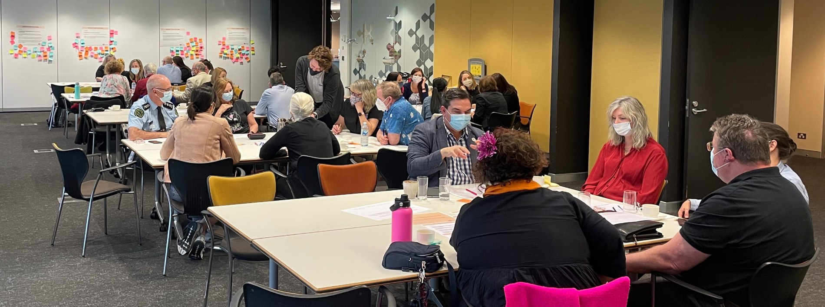


CLARITY
To prevent misunderstandings and align expectations.
Define roles and expectations clearly.
Establish open communication channels.
Ensure volunteers understand responsibilities.

Slide 7
SIMPLICITY
For a quality application, onboarding and upskilling for volunteers it is important to:
Streamline processes for easy involvement.
Offer simple, accessible training.
Utilise user-friendly tools to reduce barriers.

Slide 8
PURPOSE
To help boost motivation and long-term commitment it is important to:
Connect volunteers to the 'WHY’ of your oganisations mission and goals.
Help them see the difference they make.
Share the stories of your oganisation with them.

Slide 9
IMPACT
Understanding and being able to communicate volunteer and program impact is important as it helps:
Measure volunteer and program outcomes.
Improve retention and quality.
Share achievements and contributions regularly to increase community visibility and support.

Slide 10
PREPARE: Governance
For this section, you will need to gather the first data set. You can use the Excel spreadsheet provided or employ your own method to capture the mentioned data set for the Governance section of the review.

Slide 11



Information Gathering
In the Excel Spreadsheet provided list all of the policies and procedures are currently in place for volunteer involvement: (Include Links to each Document)
Identify who is responsible for oversight and decision-making regarding volunteers.
Document how volunteer roles align with the organisational mission.
Notes:
[Pause for a moment and engage with the audience as you begin.]
Let's delve into the crucial step of identifying who oversees and makes decisions about our volunteers.
[Emphasize the importance of this point.]
Knowing who holds responsibility ensures accountability and smooth operations.
Next, in the Excel spreadsheet we've provided, you'll find a comprehensive list of all current policies and procedures related to volunteer involvement.
[Guide them to think actively.]
Take a moment to review these documents, and you'll notice that each one includes a link for easy access. This will help you understand how well these policies are working for us.
Another key task is documenting how volunteer roles align with our organization's mission. This alignment is vital because it ensures that everyone is moving in the same direction and contributing to our overarching goals.
[Pause briefly to let this information sink in.]
By gathering this information, we're laying the groundwork for effective volunteer management, ensuring clarity and purpose in all we do.
[Encourage reflection with a gentle prompt.]
As we move forward, consider how this structured approach will aid in identifying any gaps or areas for improvement.

Slide 12
Information Review
Now that you have mapped out your current policies, procedures and processes it's time to review the current content using the below as a guide along with the resource aids provided for this section:
Are policies and procedures current and comprehensive and easy for volunteers to understand and follow? Are the easily accessed?
Based on the example governance check list provided-Are there any gaps in governance documentation?
How is a volunteer needs identification conducted?
Notes:
Let's take a closer look at our governance documentation. [Pause for a moment to engage the audience.]
Firstly, we need to assess whether there are any gaps in our current governance documentation. This means checking if we have all the necessary policies and procedures in place, and whether they are up-to-date and comprehensive. [Pause here to let the point resonate.]
Secondly, it’s crucial that these policies are easy for our volunteers to understand and follow. We must ensure they’re accessible, not just physically but also in terms of clarity and relevance. This is vital for fostering an inclusive and effective volunteering environment. [Emphasize the importance of accessibility.]
Finally, consider how we identify volunteer needs. Is there a systematic approach in place, and does it effectively capture the diverse needs of our volunteer team? An effective needs identification process is key to supporting our volunteers and aligning their roles with our organizational mission. [Pause briefly to allow the audience to reflect.]
These are the areas we need to focus on during our information review. It’s about ensuring our governance framework is robust, clear, and truly supportive of our volunteer efforts. [Conclude with a confident tone.]

Slide 13
Quality Improvement Strategy's: Governance
The following slides provide examples of strategic improvement steps that can be taken to support your programs.
We also encourage the use of the Volunteering Qld Library of resources as further support.

Slide 14
Quality Improvement Strategy: Governance
01
Develop or update a Volunteer Governance Framework:
Include policies on recruitment, training, supervision, risk management, and recognition.
Examples of Ways to Strengthen Structural and Organisational Foundations
02
03
Clarify roles and responsibilities:
Ensure board members, staff, and volunteers understand their governance and operational roles.
TIP: When updating or creating volunteer PD's use of tools like Canva Magic Write can be beneficial.
Establish a Volunteer Advisory Committee:
This group can provide insights, feedback, and oversight on volunteer-related decisions.

Slide 15
Quality Improvement Strategy: Governance
01
Conduct regular policy audits:
Review volunteer-related policies annually to ensure they align with current laws, standards, and organisational goals.
Examples of ways to Enhance Policy and Compliance Systems
02
03
Implement a compliance checklist:
Include items like background checks, confidentiality agreements, and health and safety protocols.
Tip: Writing work instructions for each step to enable continuity of business and for succession planning.
Use digital tools for documentation:
Adopt volunteer management systems that track compliance, training, and engagement metrics. eg DayForce, PageUp, BetterImpact

Slide 16
Quality Improvement Strategy: Governance
01
Create clear communication channels:
Regular updates via newsletters, meetings, or portals help volunteers stay informed and engaged.
TIP: Canva is a great and simple to use design tool
Examples of ways to Improve Stakeholder Communication and Engagement
02
03
Foster a culture of transparency:
Share governance decisions and invite feedback from volunteers and staff.
Train staff in volunteer engagement:
Equip team members with skills to manage volunteers effectively and respectfully.

Slide 17
Quality Improvement Strategy: Governance
01
Integrate volunteer management into strategic planning:
Ensure volunteer programs support the organisation’s mission and long-term objectives.
Examples of ways to Align Governance with Strategic Goals
02
03
Measure and report impact:
Use data to demonstrate how volunteers contribute to outcomes, which supports funding and accountability.
Encourage continuous improvement:
Use feedback loops and evaluation tools to refine governance practices over time.
Notes:
Let's explore how integrating volunteer management into strategic planning can significantly benefit your organization. First, it's crucial to ensure that your volunteer programs are not just stand-alone initiatives but are aligned with your organization’s mission and long-term objectives. This alignment amplifies their impact and ensures sustainability.
Next, measuring and reporting the impact of your volunteers is essential. [Pause for emphasis] Use data effectively to show how volunteers contribute to achieving outcomes. This not only supports accountability but also helps in securing funding. Remember, stakeholders are more likely to invest when they see tangible results.
Lastly, fostering a culture of continuous improvement is vital. Encourage the use of feedback loops and evaluation tools to refine and enhance governance practices continually. This approach keeps your strategies dynamic and responsive to change.
[Take a moment here to engage with the audience] How do these practices resonate with your current strategies? Think about ways you might implement similar approaches in your own governance planning.

Slide 18
PREPARE: Design
For this section, you will need to gather the second data set. You can use the Excel spreadsheet provided or employ your own method to capture the mentioned data set for the Design section of the review.

Slide 19
Information Gathering
In the Excel Spreadsheet provided list all of the existing volunteer programs and the roles that exist in each along with who is responsible for each program volunteer supervision.
Identify who is responsible for oversight and decision-making regarding current volunteer role quality standards.: (Include a link to the standard "Role Description Template” if relavent)
Detail the “Needs Identification” process and criteria (past or present or to be developed) to be utilised when developing a volunteer role.

Slide 20
Information Review
Now that you have mapped out your current roles and program information, it's time to review the current content using the below as a guide along with the resource aids provided for this section:
Are program objectives clear and are the corresponding role descriptions indicative of the required duties related to the role?
Are there gaps in role coverage or clarity? Are the roles, inclusive, and up-to-date?
How effectively are volunteer needs integrated into program design?

Slide 21
Quality Improvement Strategy's: Design
The following slides provide examples of strategic improvement steps that can be taken to support your programs.
We also encourage the use of the Volunteering Qld Library of resources as further support.

Slide 22
Quality Improvement Strategy: Design
01
Conduct Role Audits:
Engage staff and volunteers in evaluating whether roles meet current program needs.
Examples of ways to Conduct Role Audits
02
03
Review existing volunteer roles:
For clarity, relevance, and inclusivity.
Look for potential role redesign around flexible and remote options or intergenerational opportunities
Involve Volunteers in Role Planning:
Ask volunteers what they enjoy and what they’d like to do more of.
Let them help shape new roles or improve existing ones. This builds ownership and keeps people engaged.

Slide 23
Quality Improvement Strategy: Design
01
Create:
clear, consistent templates for role descriptions that are to be used across programs
Include all of the required sections for example child protection statements, privacy information- prefilled
Examples of ways to Develop and Standardise Role Descriptions
02
03
Develop a role description library:
Review it annually for updates
Train staff in volunteer role and PD development:
Equip team members with skills to design volunteer roles effectively and creatively.

Slide 24
Quality Improvement Strategy: Design
01
Annual volunteer review Survey:
Utilising platforms such as survey Monkey, survey Volunteers annually regarding role satisfaction, duty relevance, training gaps etc
Examples of ways to use Data to Inform Role Design
02
03
Volunteer Program participant feedback:
Annually Survey (at a minimum) the program participants as they may have feedback related to program delivery that may be important for role adaptation
Design a Framework for role a development matrix :
The framework serves as a guide for decision making around new role developments

Slide 25
PREPARE: Resource
For this section, you will need to gather the second data set. You can use the Excel spreadsheet provided or employ your own method to capture the mentioned data set for the Resource section of the review.

Slide 26
Information Gathering
On the Spreadsheet provided list what budget and resources are allocated to volunteer programs.
List the tools and systems used for volunteer coordination and management? ( e.g. Volunteer database and compliance tracking)
List the staff training and support that is currently is provided enabling them to work with volunteers. (e.g. Engaging with Volunteers, Volunteer management and Retention, Risk Assessment and Managment )

Slide 27
Information Review
Now that you have mapped out your current roles and program information, it's time to review the current content using the below as a guide along with the resource aids provided for this section:
Are resources sufficient and effectively utilised?
Are staff adequately supported in working with volunteers?
Are management tools current and user-friendly?

Slide 28
Quality Improvement Strategy's: Resource
The following slides provide examples of strategic improvement steps that can be taken to support your programs.
We also encourage the use of the Volunteering Qld Library of resources as further support.

Slide 29
Quality Improvement Strategy: Resource
01
Conduct a Resource Audit:
Review current financial and non-financial resources allocated to volunteer programs to identify gaps.
Budget and Resources for Volunteer Programs
02
03
Develop a Dedicated Volunteer Budge:
Include a budget line for things such as volunteer engagement, including recruitment, training, recognition, and technology.
Leverage Partnerships:
Collaborate with local businesses, community organisations, and grant programs to secure additional funding or in-kind support.

Slide 30
Quality Improvement Strategy: Resource
01
Mandatory Volunteer Management Training:
Provide onboarding and ongoing training for staff on best practices in volunteer engagement, communication, and conflict resolution.
Staff Training and Support
02
03
Create or utilise VQ's Volunteer Management Toolkit:
Develop resources such as guidelines, templates, and FAQs to support staff in managing volunteers effectively. Or utilise current resourses VQ provides and we can help tailor them to your organisation as required
Establish Peer Support Networks:
Facilitate regular meetings or forums for staff to share experiences and solutions related to volunteer coordination.

Slide 31
Quality Improvement Strategy: Resource
01
Use a Volunteer Management Tool:
Pick an easy system, MS Forms (or even a spreadsheet, FreddyMatch, BetterImpact ) to handle sign-ups, schedules, and track hours.
Stay Connected : Use email, WhatsApp, or a private Facebook group to share updates and reminders.
Tools and Systems for Volunteer Management
02
03
Track What Matters:
Keep basic records like number of volunteers, hours contributed, compliance, training and feedback from volunteers.
Make It Easy for Everyone:
Offer short guides or quick demos so volunteers and coordinators feel confident using the tools.

Slide 32
Congratulations on completing Module 1: Prepare
In this module, we focused on the first stage of the volunteer journey—Prepare, which included:
Governance: Reviewing policies, procedures, and compliance frameworks to ensure strong foundations.
Design: Assessing volunteer roles for clarity, inclusivity, and alignment with organisational objectives.
Resource Review: Evaluating budgets, staff training, and tools to support sustainable volunteer programs.
What’s next?
Future modules will build on this foundation, covering recruitment, onboarding, engagement, and recognition strategies.
Would you like a personalised walkthrough of the full VIO Training Module Series?
📧 Email us at: Info@seniors.org.au to arrange a session with a Volunteering Queensland team member.

