Slide 1

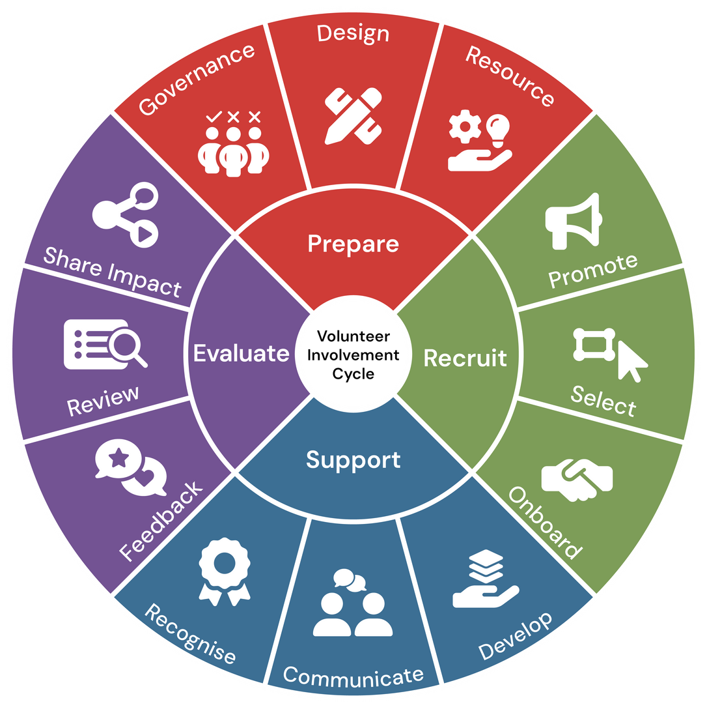

Module 2:
RECRUIT
Volunteer Involving Organisations:
Volunteer Involvement Cycle Review Workshop

Slide 2
Welcome
Whether you’re new to volunteer coordination or have years of experience, this session is designed to support you in strengthening your organisation’s approach to volunteer recruitment.
This module is focused on the Recruit stage of the Volunteer Involvement Lifecycle, which includes three key areas: Promote, Select, and Onboard. These are foundational steps that shape the volunteer experience and influence long-term engagement.
The aim of the module is to help you review your current practices, identify opportunities for improvement, and explore ways to streamline and automate your processes. We’ll be looking at each area from an organisational review perspective, and you’ll leave with practical strategies, tools, and templates you can apply immediately.
This training is aligned with the National Standards for Volunteer Involvement, and supports best practice in volunteer management. We encourage you to ask questions, share your experiences, and reflect on how these strategies can be tailored to your organisation’s unique context."

Slide 3





Facilitation
The training can be completed with a facilitator in 3x 2 hour sessions. As there are a number of data sets that need to be gathered- preparation is key to utilise the full benefit of these workshops
Independant
Resource
Instructions
The resouce can be utilised independantly at your own pace.
Resources
All resources relating to this review module can be found HERE and should be downloaded and reviewed before beginning each module
Help
Should you require help please contact us at Info@seniors.org.au

Slide 4



Objectives
General Objectives
  Understand the key components of the Recruit stage: Promote, Select, and Onboard.
  Recognise the importance of aligning recruitment practices with organisational goals and values.
  Evaluate current recruitment practices through an organisational review lens.
Promote
  Assess the effectiveness of current promotional strategies and channels.
  Apply quality improvement techniques to enhance volunteer role visibility and engagement.
  Implement streamlined procedures for consistent and efficient promotion.
  Explore automation tools to support scalable and targeted outreach.
Select
  Review selection criteria and screening processes for fairness, compliance, and role alignment.
  Utilise structured selection methods to improve consistency and reduce bias.
  Streamline selection workflows using templates and digital tools.
  Integrate automation options to simplify applicant tracking and communication.
Onboard
  Evaluate onboarding materials and delivery methods for relevance and accessibility.
  Design personalised and engaging onboarding experiences for diverse volunteer roles.
  Standardise onboarding procedures to ensure clarity and efficiency.
  Leverage automation to track onboarding progress and maintain engagement.
Strategic Integration
  Link recruitment outcomes to broader organisational strategy and volunteer retention goals.
  Use data and feedback to inform continuous improvement in recruitment practices.

Slide 5
Recruit: Promote
For this section, you will need to gather the first data set. You can use the Excel spreadsheet provided or employ your own method to capture the mentioned data set for the Governance section of the review.

Slide 6



Information Gathering
  In the Excel Spreadsheet provided list Audit current promotional channels (social media, website, newsletters).
  Identify who is responsible for Comms/Marketing and social media content.
  Outline process for social media posting and budget if any.
  Map out the communications, emails, phone calls, meeting invitations to potential volunteer EOI's.
Notes:
[Pause for a moment and engage with the audience as you begin.]
Let's delve into the crucial step of identifying who oversees and makes decisions about our volunteers.
[Emphasize the importance of this point.]
Knowing who holds responsibility ensures accountability and smooth operations.
Next, in the Excel spreadsheet we've provided, you'll find a comprehensive list of all current policies and procedures related to volunteer involvement.
[Guide them to think actively.]
Take a moment to review these documents, and you'll notice that each one includes a link for easy access. This will help you understand how well these policies are working for us.
Another key task is documenting how volunteer roles align with our organisation's mission. This alignment is vital because it ensures that everyone is moving in the same direction and contributing to our overarching goals.
[Pause briefly to let this information sink in.]
By gathering this information, we're laying the groundwork for effective volunteer management, ensuring clarity and purpose in all we do.
[Encourage reflection with a gentle prompt.]
As we move forward, consider how this structured approach will aid in identifying any gaps or areas for improvement.

Slide 7
Information Review
Now that you have mapped out your current promotional avenues, its time to review using the guide below, along with the resource aids provided for this section:
  Evaluate branding and visual identity across platforms to ensure alignment with organisational values and goals.
  Review analytics and performance metrics (e.g. website traffic, social media insights, email open rates) to identify trends and areas for improvement. - If Available
  Gather feedback from staff and stakeholders on the effectiveness and clarity of current promotional efforts, consistency of messaging and Identify gaps in communication or missed opportunities for engagement across existing channels.
Notes:
Let's take a closer look at our governance documentation. [Pause for a moment to engage the audience.]
Firstly, we need to assess whether there are any gaps in our current governance documentation. This means checking if we have all the necessary policies and procedures in place, and whether they are up-to-date and comprehensive. [Pause here to let the point resonate.]
Secondly, it’s crucial that these policies are easy for our volunteers to understand and follow. We must ensure they’re accessible, not just physically but also in terms of clarity and relevance. This is vital for fostering an inclusive and effective volunteering environment. [Emphasize the importance of accessibility.]
Finally, consider how we identify volunteer needs. Is there a systematic approach in place, and does it effectively capture the diverse needs of our volunteer team? An effective needs identification process is key to supporting our volunteers and aligning their roles with our organizational mission. [Pause briefly to allow the audience to reflect.]
These are the areas we need to focus on during our information review. It’s about ensuring our governance framework is robust, clear, and truly supportive of our volunteer efforts. [Conclude with a confident tone.]

Slide 8
Quality Improvement Strategies: Promote
Quality promotion is about storytelling and relevance. Share real volunteer stories. Tailor your message to different groups. A retiree may respond to community impact, while a student may seek skill-building.
The following slides provide examples of strategic improvement steps that can be taken to support your programs.
We also encourage the use of the Volunteering Qld Library of resources as further support.

Slide 9






  QUALITY IMPROVEMENT STRATEGIES: PROMOTE
  Use impact stories to connect emotionally with potential volunteers
  Try different content styles
  Share real-life examples of how volunteers have made a difference in the community.
  Highlight personal journeys, challenges overcome, and the ripple effect of their contributions to inspire and build trust.
  Use videos, photo slideshows, and quotes from volunteers. See what people like best and keep improving based on what works.
  Speak to different groups
  Use content from volunteers
  Create messages that suit different types of people—like young people, retirees, or working professionals.
  Focus on what matters to each group, like learning new skills, finding purpose, or giving back through work.
  Utilise tools like Canva/Canva Magic write for promotional content creation.
  Ask volunteers to share their own photos or stories.
  This makes your content feel more real and helps others see what it’s like to be involved.
  Add clear calls to action
  Make sure every post tells people what to do next—like “Join now,” “Volunteer today,” or “Come to our info session.”
  Post at the right times: Look at when your audience is online and post then. Keep a regular schedule so people know when to expect updates

Slide 10
Examples of recruitment promotional strategies.
Strategy | Description
Social Media Campaigns | Targeted Ads: Use social media platforms like Facebook, Instagram, and LinkedIn to run targeted ads aimed at specific demographics. Influencer Partnerships: Collaborate with local influencers or community leaders to promote volunteer opportunities.
Volunteer Referral Programs | Incentives for Referrals: Encourage current volunteers to refer friends and family by offering incentives such as recognition, rewards, or small gifts. Referral Contests: Organise contests where volunteers can win prizes for referring the most new volunteers.
Community Outreach | Pop-Up Recruitment Events: Host pop-up events in high-traffic areas like shopping centre’s, parks, or community centres to engage with potential volunteers. Partnerships with Local Businesses: Collaborate with local businesses to display recruitment materials or host joint events.
Virtual Recruitment Fairs | Online Webinars and Info Sessions: Host virtual events where potential volunteers can learn about your organisation and ask questions. Virtual Open Houses: Offer virtual tours of your organisation and introduce key staff members.
Quality Improvement Strategy: Promote

Slide 11
Examples of recruitment promotional strategies.
Strategy | Description
Storytelling and Content Marketing | Volunteer Spotlights: Share stories and testimonials from current volunteers on your website and social media. Impact Videos: Create short videos showcasing the impact of your volunteers' work and share them widely.
Alumni Networks | Engage Former Volunteers: Reach out to former volunteers and invite them to return or refer new volunteers. Alumni Events: Host events specifically for former volunteers to reconnect and share their experiences.
Corporate Partnerships | Employee Volunteer Programs: Partner with companies to create employee volunteer programs where staff can volunteer as part of their work. Corporate Sponsorships: Seek sponsorships from businesses that can provide resources or promote your volunteer opportunities.
Niche Recruitment | Special Interest Groups: Target recruitment efforts towards specific interest groups, such as environmental clubs, sports teams, or hobby groups. Skill-Based Recruitment: Focus on recruiting volunteers with specific skills needed for particular projects or roles.
Volunteer Ambassadors | Ambassador Programs: Develop a program where passionate volunteers act as ambassadors to promote your organization and recruit new volunteers. Peer-to-Peer Recruitment: Encourage volunteers to share their experiences and recruit peers through word-of-mouth.
Quality Improvement Strategy: Promote

Slide 12
  QUALITY IMPROVEMENT STRATEGIES: STREAMLINING PROCEDURES
  Create a promotional calendar for recurring roles
  Set up a simple approval process
  Plan ahead by mapping out when and how often key volunteer roles need to be promoted.
  This helps avoid last-minute rushes and keeps messaging consistent throughout the year.
  Create a clear workflow for reviewing and approving promotional content. This helps avoid delays and ensures messaging stays on-brand.
  Automate posting by using tools like Meta Business Suite or Buffer. This saves time and ensures regular updates without manual effort.
  Make templates for role descriptions and social media posts
  Keep a checklist for each campaign
  Store all assets in one shared location
  Use a simple checklist to track tasks like writing content, designing graphics, getting approvals, and posting.
  This helps make sure nothing gets missed.
  Save time by creating ready-to-use templates for common volunteer roles and posts. These can be easily updated with new details and reused across different platforms.
  Keep images, logos, templates, and documents in a shared drive or content management system (CMS). This makes it easy for everyone to find what they need and keeps things organised.

Slide 13
  QUALITY IMPROVEMENT STRATEGIES: AUTOMATION OPTIONS
Use scheduling tools (Buffer, Hootsuite) for social media -
  (If budget permits.)
  Integrate volunteer platforms (e.g., Better Impact, Volaby) to auto-post roles
  Automate posting across multiple platforms to save time and maintain consistency.
  These tools allow you to plan content weeks in advance, schedule posts for peak engagement times, and track performance analytics in one dashboard.
  Connect your volunteer management system with your website or social media channels so new roles are automatically published.
  This reduces manual updates and ensures opportunities are visible as soon as they’re available.
  Enable automated reminders and confirmations
Automate email campaigns
  (via Mailchimp or HubSpot)
Use automation to send reminders for upcoming shifts, training sessions, or events. This helps reduce no-shows and keeps volunteers informed without extra admin work.
  Set up automated workflows for volunteer onboarding, event reminders, and newsletters.
  Use segmentation features to send tailored messages to different audience groups and track open rates and click-throughs for continuous improvement.

Slide 14
Example of a Communications plan
Strategy | Description
Phase 1: Awareness & Attraction | Key Actions: Social Media Posts: Share impact stories, role highlights, and clear calls to action (e.g., “Join us to make a difference!”). Website Updates: Ensure volunteer page is easy to find, with clear role descriptions and application steps. Email Campaign: Send an introductory email to your mailing list promoting volunteer opportunities. Community Outreach: Post flyers or digital notices in local groups and forums.
Phase 2: Interest & Engagement | Key Actions: Acknowledgment Email: Immediately confirm receipt of application with a friendly message and next steps. Follow-Up Content: Share FAQs, benefits of volunteering, and short videos about the organisation’s impact. Personal Touch: Respond promptly to inquiries via email or social media to build trust.
Phase 3: Pre-Interview Preparation | Key Actions: Interview Invitation Email: Send a clear, warm invitation with date/time options and instructions. Reminder Email/SMS: Send a reminder 24–48 hours before the interview. Provide Resources: Include links to role descriptions, organisational values, and any documents they need to bring.
Quality Improvement Strategy: Promote

Slide 15
Recruit: Select
For this section, you will need to gather the second data set. You can use the Excel spreadsheet provided or employ your own method to capture the mentioned data set for the Design section of the review.

Slide 16
Information Gathering
  Gather selection criteria/ interview note templates/reference check templates, and interview process documents.
  Map out the communications, emails, phone calls, meeting invitations for this section.

Slide 17
Information Review
Now that you have mapped out your current roles and program information, it's time to review the current content using the below as a guide along with the resource aids provided for this section:
  Review selection criteria & interview questions for fairness and relevance and creative questioning.
  Check that the criteria align with organisational values, legal requirements, and the actual needs of the role.
  Are there standardised forms/processes and templates maintaining quality standards.
  Are compliance requirements covered?
  Are documents/interview notes etc stored securely?

Slide 18
Quality Improvement Strategies: Select
The following slides provide examples of strategic improvement steps that can be taken to support your programs.
We also encourage the use of the Volunteering Qld Library of resources as further support.

Slide 19
  QUALITY IMPROVEMENT STRATEGIES: SELECT
  Use structured interviews or scenario-based questions
  Privacy & Data Security
  Develop a consistent set of questions for all candidates to ensure fairness. Include scenario-based questions that test problem-solving and decision-making relevant to the volunteer role.
  This helps assess practical skills, not just theoretical knowledge.
  Store applicant information in secure systems that comply with data protection laws
  Limit access, use encrypted platforms for communication and storage, and clearly inform applicants how their data will be used and obtain consent
  Ensure all those handling sensitive data and information are trained in handling.
  Ensure those who conduct the interviews are confident and trained.
  Collect feedback from applicants to refine processes
  After interviews, send a short survey asking about clarity of communication, ease of application, and overall experience.
  Use this feedback to identify pain points and improve the process.
  Provide short training sessions or guides to help interviewers maintain professionalism during interviews.
  The training can inform the tone- informal chat, or more formal -depending on the type of role or program
  Document
  Keep records of interview questions, scoring sheets, and feedback.
  Schedule periodic reviews to update processes based on lessons learned and organisational changes.

Slide 20
  QUALITY IMPROVEMENT STRATEGIES: STREAMLINING PROCEDURES
  Standardise interview questions
  Create role-specific selection checklists
  Prepare a set of core questions for all interviews, along with a scoring rubric.
  This ensures fairness and makes it easier to compare candidates objectively.
  Develop a checklist for each volunteer role that outlines required qualifications, documents, and steps in the selection process.
  This ensures consistency and helps interviewers quickly verify that all criteria are met.
  Use online forms for references and screening
  Centralise documentation in a shared system
  Replace manual reference checks and screening questionnaires with secure online forms.
  This speeds up data collection, reduces errors, and allows easy tracking of responses in one central location.
  Store all templates, checklists, and completed forms in a secure shared drive or volunteer management platform.
  This makes it easy for team members to access and update materials.

Slide 21
  QUALITY IMPROVEMENT STRATEGIES: AUTOMATION OPTIONS
  Use CRM or volunteer platforms to auto-tag applicants by skills
  Integrate Police Check tracking with onboarding systems
  Configure your CRM or volunteer management system (e.g., Better Impact, Volaby, Salesforce Nonprofit Cloud) to automatically tag applicants based on keywords in their application or uploaded documents.
  This helps quickly match volunteers to suitable roles and reduces manual sorting.
  Connect your Police Check process (e.g., via National Crime Check or CrimCheck) with your volunteer management platform so status updates (submitted, cleared, pending) sync automatically.
  This ensures compliance and saves time chasing paperwork
  Automate reference requests and reminders
  Enable automated notifications for application progress
  Set up automated workflows to send reference check forms via email as soon as an applicant reaches the relevant stage.
  Include reminders for referees who haven’t responded within a set timeframe.
  Tools like Mailchimp, HubSpot, or built-in features in volunteer platforms can handle this seamlessly.
  Create dashboards for real-time monitoring
  Use your platform or CRM to send status updates (e.g., “Application received,” “Interview scheduled,” “Onboarding complete”) without manual intervention.
  This improves transparency and keeps volunteers engaged.
  Automate data collection from all integrated systems into a single dashboard (e.g., Power BI, Google Data Studio).
  This gives you instant visibility on recruitment progress, pending checks, and volunteer readiness.

Slide 22
Example of a plan for Communications templates plan
Strategy | Description
Outcome Notification- Successful Applicants
Outcome Notification- Unsuccessful Applicants
Compliance Check Follow-Up
Training Invitation
Training Completion & Welcome
Quality Improvement Strategy: Select

Slide 23
Recruit: Onboard

Slide 24
Information Gathering
  On the Spreadsheet provided list all documents, guides, and training resources.
  Map out current onboarding processes and procedures, systems, communications and who is responsible for each stage of onboarding.
  Map out what training and compliance are required for each role.

Slide 25
Information Review
Now that you have mapped out your current roles and program information, it's time to review the current content using the below as a guide along with the resource aids provided for this section:
  Are all documents, guides, and training resources up-to-date, easy to understand, and reflect current organisational policies and volunteer roles?
  If onboarding involves online systems, confirm they are user-friendly and provide clear instructions for login, navigation, and completion.
  Is the volunteer induction training up to date and relevant to the needs of the programs?
  Are management tools current and user-friendly?
  Are there any gaps in the onboarding process?

Slide 26
Quality Improvement Strategies: Onboard
Quality onboarding builds commitment. Personalisation shows you care. Interactive elements keep volunteers engaged.
The following slides provide examples of strategic improvement steps that can be taken to support your programs.
We also encourage the use of the Volunteering Qld Library of resources as further support.

Slide 27
  QUALITY IMPROVEMENT STRATEGIES: ONBOARD
  Workplace orientation
  Update Training: Include interactive elements (videos, quizzes, peer mentoring)
  Include a structured orientation that covers the physical workspace, safety procedures, and introductions to key staff.
  This helps volunteers feel comfortable and confident from day one.
  Use short videos to explain key processes, interactive quizzes to reinforce learning, and peer mentoring opportunities to build confidence.
  This makes onboarding engaging and helps volunteers retain information.
  Introduce a buddy system for new volunteers
  Collect feedback and iterate regularly
  Pair new volunteers with experienced ones for their first few shifts.
  This provides real-time support, builds relationships, and reduces anxiety during the transition.
  Provide clear next steps and timelines
  After onboarding, ask volunteers for feedback on clarity, usefulness, and overall experience.
  Use surveys or quick check-ins to identify gaps and continuously improve the process.
  Give volunteers a simple roadmap showing what happens after onboarding—such as compliance checks, training completion, and first shift scheduling.

Slide 28
  QUALITY IMPROVEMENT STRATEGIES: STREAMLINING
  Use onboarding templates with standard tasks & Communications
  Create a central onboarding hub (intranet or LMS)
  Create reusable templates for welcome emails, compliance instructions, training invitations, and reminders.
  This ensures consistency and saves time for staff when communicating with new volunteers
  Standardise email and SMS templates for each stage—post-interview, compliance checks, training reminders, and welcome messages. Include clear instructions and deadlines in every template.
  Develop a single online location where volunteers can access all onboarding materials, training modules, FAQs, and contact details.
  This improves accessibility and reduces confusion.
  Digitise forms and agreements
  Set up online surveys and feedback forms
  Convert paper-based forms (e.g., consent, compliance checks, policy acknowledgments) into secure online forms.
  This reduces manual handling, speeds up processing, and improves record-keeping.
  Use tools like Microsoft Forms, Google Forms, or SurveyMonkey to collect feedback after onboarding and training.

Slide 29
  QUALITY IMPROVEMENT STRATEGIES: AUTOMATION
  Auto-enrol volunteers into onboarding sequences
  Automate compliance notifications
  Integrate Police Check and Working With Children Check systems with your onboarding platform so volunteers receive automated alerts when checks are approved or pending.
  Create automated SMS updates for key milestones using tools like Twilio or ClickSend to send short reminders for interviews, compliance deadlines, and training sessions.
  Configure your volunteer management system (e.g., Better Impact, Volunteering Gateway, Salesforce Nonprofit Cloud) to automatically add successful applicants to an onboarding workflow.
  This can include compliance checks, training modules, and orientation steps without manual intervention.
  Trigger follow-up emails and training reminders
  Centralise communication templates in your CRM
  Use automation tools like HubSpot, Mailchimp, or built-in CRM workflows to send timely communications.
Examples:
  Immediately after compliance completion: “Great job! Next step: Book your training session here [link].”
  24 hours before training: “Reminder: Your training is tomorrow at [time].”
  Set up automated surveys for feedback
  Store all email and SMS templates for onboarding stages in your CRM or volunteer platform so they can be auto-populated and sent at the right time.
  After onboarding or training, trigger an online survey (via Google Forms, Microsoft Forms, or SurveyMonkey) to collect feedback without manual follow-up.

Slide 30
Congratulations on completing Module 2: Recruit
In this module, we focused on the Recruit stage of the Volunteer Involvement Lifecycle, which included:
  Promote – Assessing and improving promotional strategies and outreach.
  Select – Reviewing and streamlining selection criteria, interviews, and compliance processes.
  Onboard – Designing engaging onboarding experiences and leveraging automation for efficiency.
What’s next?
  Future modules will build on this foundation, covering recruitment, onboarding, engagement, and recognition strategies.
Would you like a personalised walkthrough of the full VIO Training Module Series?
  📧 Email us at: Info@seniors.org.au to arrange a session with a Volunteering Queensland team member.

