Slide 1

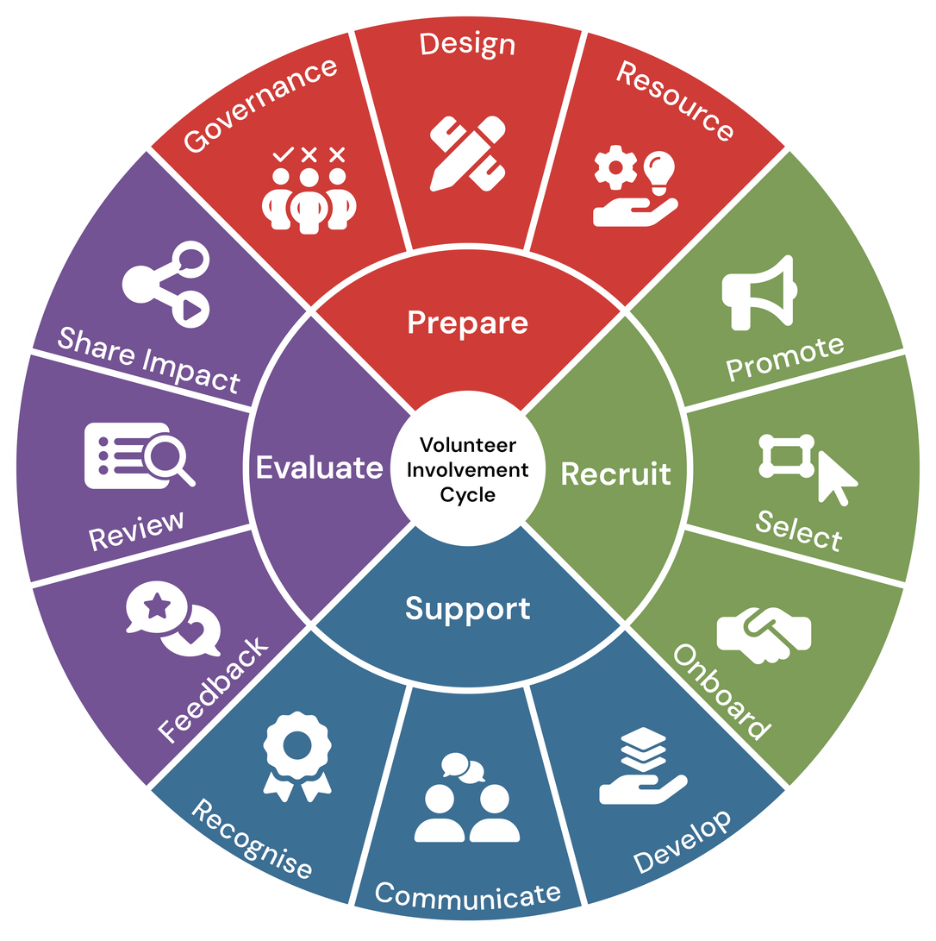

Module 4:
Evaluate
Volunteer Involving Organisations:
Volunteer Involvement Cycle Review Workshop

Slide 2
Welcome
Whether you’re new to volunteer coordination or have years of experience, this session is designed to support you in strengthening your organisation’s approach to supporting volunteers.
The Evaluate stage is the final phase in the volunteer management cycle. It focuses on assessing the effectiveness of your volunteer program, gathering insights, and using those insights to improve future planning and delivery. It’s about asking: What worked? What didn’t? And how can we do better?
Why It Matters
Closing the Loop: Evaluation ensures that feedback and experiences are not just collected, but acted upon.
Continuous Improvement: It helps organisations refine their strategies, processes, and volunteer support systems.
Volunteer Retention: Volunteers who feel heard and see improvements based on their input are more likely to stay engaged and committed.
Accountability and Transparency: Evaluation builds trust with stakeholders by showing how outcomes are measured and shared.
The aim of the module is to help you review your current practices, identify opportunities for improvement, and explore ways to streamline and automate your processes. We’ll be looking at each area from an organisational review perspective, and you’ll leave with practical strategies, tools, and templates you can apply immediately.
This training is aligned with the National Standards for Volunteer Involvement, and supports best practice in volunteer management. We encourage you to ask questions, share your experiences, and reflect on how these strategies can be tailored to your organisation’s unique context.

Slide 3





Facilitation
The training can be completed with a facilitator in 3x 2 hour sessions. As there are a number of data sets that need to be gathered- preparation is key to utilise the full benefit of these workshops
Resource
Instructions
Independant
The resouce can be utilised independantly at your own pace.
Resources
All resources relating to this review module can be found under this section of the Module Webpage and should be downloaded and reviewed before beginning each module.
Help
Should you require help please contact us at Info@seniors.org.au

Slide 4


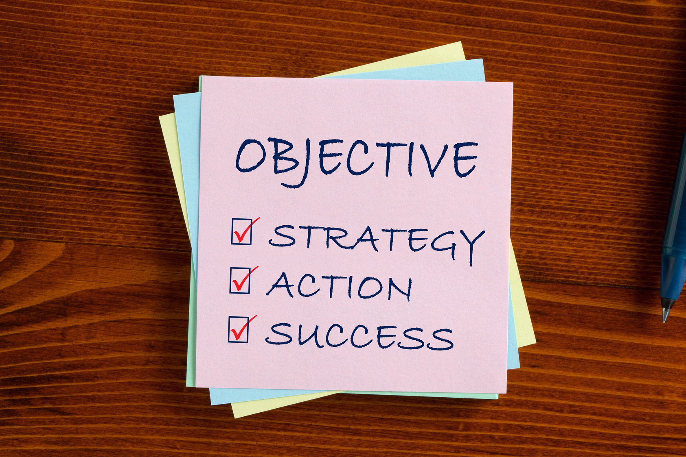
Objectives
Identify effective methods for collecting volunteer feedback,
Including formal and informal approaches.
Apply review techniques to assess program performance,
Volunteer satisfaction, and alignment with organisational goals.
Develop strategies to share impact stories and evaluation outcomes with stakeholders, volunteers, and the broader community.
Integrate evaluation findings into future planning to support continuous improvement and volunteer retention.
Use tools and templates to facilitate feedback collection, data analysis, and impact reporting.
Apply review techniques to assess program performance, volunteer satisfaction, and alignment with organisational goals.

Slide 5
Evaluate: Feedback
The Feedback stage is a vital part of the evaluation process. It involves actively listening to volunteers, staff, and stakeholders to understand their experiences, challenges, and suggestions. Gathering feedback helps organisations identify what’s working well and where improvements are needed.
Effective feedback collection creates a culture of openness and trust, where volunteers feel valued and heard. It also provides the foundation for meaningful change, ensuring that volunteer programs remain responsive, inclusive, and impactful.
For this section, you will need to gather the first data set. You can use the Excel spreadsheet provided or employ your own method to capture the mentioned data set for the Feedback section of the review.

Slide 6



Information Gathering
In the Excel Sheet provided list all feedback mechanisms that currently exist?
Who collects and reviews feedback?
Frequency and consistency of feedback collection and Tools used (manual, digital, hybrid).
Notes:
[Pause for a moment and engage with the audience as you begin.]
Let's delve into the crucial step of identifying who oversees and makes decisions about our volunteers.
[Emphasize the importance of this point.]
Knowing who holds responsibility ensures accountability and smooth operations.
Next, in the Excel spreadsheet we've provided, you'll find a comprehensive list of all current policies and procedures related to volunteer involvement.
[Guide them to think actively.]
Take a moment to review these documents, and you'll notice that each one includes a link for easy access. This will help you understand how well these policies are working for us.
Another key task is documenting how volunteer roles align with our organization's mission. This alignment is vital because it ensures that everyone is moving in the same direction and contributing to our overarching goals.
[Pause briefly to let this information sink in.]
By gathering this information, we're laying the groundwork for effective volunteer management, ensuring clarity and purpose in all we do.
[Encourage reflection with a gentle prompt.]
As we move forward, consider how this structured approach will aid in identifying any gaps or areas for improvement.

Slide 7
Information Review
Now that you have mapped out your current evaluation and feedback processes it's time to review the current content using the below as a guide along with the resource aids provided for this section:
Are feedback channels accessible and inclusive?
Available in multiple languages or formats?
Consideration for neurodiversity and digital literacy?
Is feedback acted upon or acknowledged?
Are volunteers informed of changes made due to feedback?
Is there a visible response timeline or process?
Are volunteers aware of how their feedback is used?
What feedback trends have emerged?
Recurring themes (e.g., communication gaps, recognition)
Positive highlights and areas for improvement
Notes:
Let's take a closer look at our governance documentation. [Pause for a moment to engage the audience.]
Firstly, we need to assess whether there are any gaps in our current governance documentation. This means checking if we have all the necessary policies and procedures in place, and whether they are up-to-date and comprehensive. [Pause here to let the point resonate.]
Secondly, it’s crucial that these policies are easy for our volunteers to understand and follow. We must ensure they’re accessible, not just physically but also in terms of clarity and relevance. This is vital for fostering an inclusive and effective volunteering environment. [Emphasize the importance of accessibility.]
Finally, consider how we identify volunteer needs. Is there a systematic approach in place, and does it effectively capture the diverse needs of our volunteer team? An effective needs identification process is key to supporting our volunteers and aligning their roles with our organizational mission. [Pause briefly to allow the audience to reflect.]
These are the areas we need to focus on during our information review. It’s about ensuring our governance framework is robust, clear, and truly supportive of our volunteer efforts. [Conclude with a confident tone.]

Slide 8
Quality Improvement Strategies: Feedback
The following slides provide examples of strategic improvement steps that can be taken to support your programs.
We also encourage the use of the Volunteering Qld Library of resources as further support.

Slide 9

QUALITY IMPROVEMENT STRATEGIES: FEEDBACK
Develop a feedback framework with clear objectives
Train staff on active listening and response protocols
Create feedback loops with visible outcomes
Define purpose, scope, and expected outcomes
Establish why feedback is being collected (e.g., improve volunteer experience, enhance program delivery), what areas it will cover (e.g., onboarding, training, recognition), and what success looks like.
Include co-design elements with volunteers where possible.
Include measurable indicators and timelines.
Include empathy, non-defensive communication, and follow-up
Equip staff with skills to receive feedback constructively, validate volunteer experiences, and respond with care and professionalism.
Practice real-life feedback situations to build confidence and consistency in handling sensitive or critical input.
Share “You said, we did” updates
Regularly communicate changes made based on volunteer feedback through newsletters, meetings, or dashboards.
Celebrate implemented suggestions publicly
Close the loop with individual follow-ups when appropriate
Where feasible, respond directly to volunteers who provided specific suggestions
1
2
3

Slide 10
QUALITY IMPROVEMENT STRATEGIES: STREAMLINING & AUTOMATION
Use tools like Google Forms, Typeform, or CRM-integrated surveys
Automate feedback reminders post-events or shifts
Centralise feedback data
Ensure mobile accessibility and ease of use
Design surveys that are quick to complete on phones or tablets, with clear instructions and minimal friction.
Embed surveys in volunteer portals or emails
Integrate feedback requests into existing communication channels to increase visibility and response rates.
Personalise surveys based on volunteer roles or experiences for more relevant insights.
Set up automatic prompts to gather feedback immediately after participation, while experiences are fresh.
Include thank-you messages and links to feedback forms
Pair reminders with appreciation to foster a positive tone and encourage engagement.
Use automation to follow up with non-respondents without overwhelming them.
Use shared drives or dashboards to store and view feedback in one place
Group feedback by themes like training, communication, or recognition
Connect feedback tools with reporting systems to get quick insights and support timely decisions
1
2
3

Slide 11
Quality Improvement Strategy: Creative Enhancements
Strategy
Introduce “Feedback Walls” (digital or physical) | Interactive boards at events or online platforms Allow volunteers to post thoughts, ideas, or reflections in a communal space. Use sticky notes, emojis, or comment threads Make feedback fun and expressive, encouraging spontaneous contributions. Rotate themes or questions regularly Keep engagement fresh by focusing on different topics each month or quarter.
Gamify feedback (e.g., badges for participation) | Reward consistent contributors Recognise volunteers who regularly provide feedback with digital badges, certificates, or shout-outs. Create friendly competition between teams Encourage team-based feedback challenges with small incentives or recognition. Track participation and celebrate milestones Share progress and celebrate when feedback goals are met.
Host feedback cafés | Informal gatherings with refreshments Create relaxed environments where volunteers feel comfortable sharing openly. Encourage storytelling and open dialogue Use prompts or themes to guide conversation and surface deeper insights. Facilitate by trained staff or peer leaders Ensure sessions are inclusive, respectful, and productive.

Slide 12
Evaluate: Review
Reviewing volunteer programs is a vital process that helps organisations reflect on performance, engagement, and alignment with strategic goals. It goes beyond data collection—bringing together insights from staff, volunteers, and stakeholders to understand what’s working, what needs improvement, and how programs can evolve.
A thoughtful review process ensures that volunteer contributions are valued, lessons are learned, and future planning is informed by real experiences and measurable outcomes.
For this section, you will need to gather the second data set. You can use the Excel spreadsheet provided or employ your own method to capture the mentioned data set for the Review section of this module.

Slide 13
Information Gathering
Gather information on what review processes are in place.
Who is responsible for reviewing volunteer programs, management practices, and volunteer quality experience?
Who is involved in reviews? What data is used? (qualitative, quantitative)

Slide 14
Information Review
Now that you have mapped out your current communication information, it's time to review the current content using the below as a guide along with the resource aids provided for this section:
Are reviews inclusive of volunteer perspectives?
Do volunteers have opportunities to contribute to reviews?
Are their voices represented in final reports or decisions?
What metrics are used to assess success?
Are KPIs clearly defined and relevant to volunteer goals?
Is there a balance between numbers and narrative?
Are reviews linked to strategic planning?
Do findings inform future program design or funding decisions?
Is there a feedback loop between review outcomes and action plans?

Slide 15
Quality Improvement Strategies: Review
The following slides provide examples of strategic improvement steps that can be taken to support your programs.
We also encourage the use of the Volunteering Qld Library of resources as further support.

Slide 16
QUALITY IMPROVEMENT STRATEGIES: REVIEW
Include volunteers in review committees
Use SWOT analysis for program evaluation
Include volunteers in review committees
Invite volunteers to co-lead or contribute to review processes
Ensure diverse representation across roles and backgrounds
Build trust and transparency through shared decision-making
Identify strengths, weaknesses, opportunities, and threats
Facilitate collaborative workshops to explore findings
Use results to guide strategic improvements and innovation
1
2

Slide 17
QUALITY IMPROVEMENT STRATEGIES: STREAMLINING & AUTOMATION
Schedule regular review cycles with templates
Automate report generation from CRM systems
Pull data directly from volunteer management platforms
Use templates to standardise reporting across programs
Reduce manual workload and improve consistency
Create calendar reminders for quarterly or annual reviews
Use pre-designed templates to guide review discussions
Ensure continuity and accountability in review processes
1
2
3

Slide 18
Quality Improvement Strategy: Creative Enhancements
Strategy | Description
Visual storytelling in review reports | Use photos, quotes, and infographics to bring data to life Highlight volunteer journeys and community impact Make reports more engaging and accessible
Volunteer-led review presentations | Empower volunteers to present findings or share experiences Include peer-to-peer insights and recommendations Foster ownership and pride in program outcomes
Use infographics to share findings internally | Summarise key insights in visual formats for staff and stakeholders Display in common areas or internal newsletters Encourage ongoing reflection and dialogue

Slide 19
Evaluate: Share Impact
This stage is about reflecting on the outcomes of volunteer engagement and clearly demonstrating the difference their contributions have made.
By evaluating activities and sharing impact stories, we not only acknowledge the value volunteers bring to our community but also build trust and buy-in from stakeholders.
Transparent reporting of results strengthens relationships, supports future planning, and provides evidence for grants and funding applications.
Celebrating achievements and communicating measurable impact ensures volunteers feel appreciated while reinforcing the program’s credibility and sustainability.

Slide 20
Information Gathering
On the Spreadsheet provided list all current impact that data is collected?
Volunteer hours and attendance records
Program outcomes (e.g., meals served, events supported)
Volunteer stories, testimonials, and feedback
Recognition data (e.g., awards, milestones)
Who is responsible for gathering the information?
How is impact currently shared?

Slide 21
Information Review
Now that you have mapped out your current Impact and program information, it's time to review the current content using the below as a guide along with the resource aids provided for this section:
Is impact communicated in a way that resonates?
Are stories authentic and emotionally engaging?
Is the language inclusive and accessible?
Are volunteers celebrated publicly?
Are achievements acknowledged in newsletters, social media, or events?
Is recognition timely and meaningful?
Is impact linked to organisational goals?
Does shared impact demonstrate progress toward strategic priorities?
Are volunteers aware of how their work contributes to broader outcomes?

Slide 22
Quality Improvement Strategies: Develop
The following slides provide examples of strategic improvement steps that can be taken to support your programs.
We also encourage the use of the Volunteering Qld Library of resources as further support.

Slide 23
QUALITY IMPROVEMENT STRATEGIES: SHARE IMPACT
Develop an impact communication plan
Align volunteer impact with strategic outcomes
Collect stories alongside statistics
Define key messages, audiences, channels, and frequency
Identify what stories and data you want to share, who needs to hear them (e.g., volunteers, funders, community), and how often (monthly, quarterly, annually).
Combine statistics with real-life stories and engaging visuals to create a compelling narrative.
Map volunteer activities to organisational goals
Clearly show how volunteer efforts contribute to outcomes like community wellbeing, service delivery, or advocacy.
Use impact data to support funding proposals and advocacy
Include volunteer impact in grant applications, reports to donors, and public campaigns.
Share results in strategic planning sessions
Ensure leadership visibility and buy-in
Create opportunities for volunteers to share their experiences in structured or informal ways.
Encourage volunteers to share their experiences in their own words
Pair stories with relevant metrics to illustrate both scale and depth of impact.
Include voices from different roles, backgrounds, and experiences to reflect the full spectrum of volunteer involvement.
1
2
3

Slide 24
Quality Improvement Strategy: Streamlining & Automation
Strategy | Description
Use templates for impact reports | Standardise layout and content structure Create consistent formats for reports that include sections like key achievements, volunteer highlights, and program outcomes. Include sections for data, stories, visuals, and quotes Ensure each report is engaging and informative by balancing numbers with human stories. Make templates adaptable for different audiences Tailor versions for internal use, funders, community partners, or public sharing.
Automate social media scheduling for impact posts | Use tools like MailChimp or Campaign Monitor to plan and publish content Schedule posts in advance to maintain a consistent presence. Schedule regular posts highlighting volunteer achievements Feature milestones, testimonials, and program updates to keep audiences engaged. Use analytics to understand what content resonates and adjust accordingly. Plan themes and campaigns around key dates like National Volunteer Week or program anniversaries
Integrate volunteer data with storytelling platforms | Use CRM or volunteer management systems to pull data - Automatically gather metrics like hours served, event participation, and feedback scores. Link with platforms like Canva or Adobe Express for visual storytelling Easily create infographics, posters, and social media graphics using real-time data. Enable cross-team collaboration Allow marketing, volunteer coordination, and leadership teams to access and contribute to shared content.

Slide 25
Quality Improvement Strategy: Creative Enhancements
Strategy | Description
Host annual volunteer impact showcases | Celebrate achievements with presentations, awards, and stories Create a festive event that honours volunteer contributions and shares program outcomes. Invite stakeholders and community members Strengthen relationships and raise awareness by including funders, partners, and local leaders. Combine celebration with strategic communication to maximise visibility. Use videos, photo displays, or live storytelling to engage attendees.
Sharing Stories | Create short videos or podcasts featuring volunteers Share personal stories, reflections, and program highlights Post on social media, websites, and newsletters to expand reach. Ensure representation across age groups, backgrounds, and roles. Focus on real stories told in volunteers’ own words for maximum impact.
Digital Tracking | Monitor training completion, progress, and outcomes. Allow stakeholders to explore data on volunteer hours, program outcomes, and engagement levels. Make dashboards user-friendly and customisable for different needs. Make dashboards visually engaging and easy to navigate Embed dashboards in reports or presentations

Slide 26
Congratulations on completing Module 4: Evaluate
In this module, we focused on the fourth and final stage of the volunteer involvement lifecycle—evaluate- which included:
Feedback: Gathering and responding to volunteer input to improve experiences and systems.
Review: Reflecting on organisational practices, volunteer program outcomes, and alignment with strategic goals.
Share Impact: Communicating the value and outcomes of volunteer contributions to internal and external stakeholders.
What’s next?
Future modules will build on this foundation, covering recruitment, onboarding, engagement, and recognition strategies.
Would you like a personalised walkthrough of the full VIO Training Module Series?
📧 Email us at: Info@seniors.org.au to arrange a session with a Volunteering Queensland team member.

