Slide 1

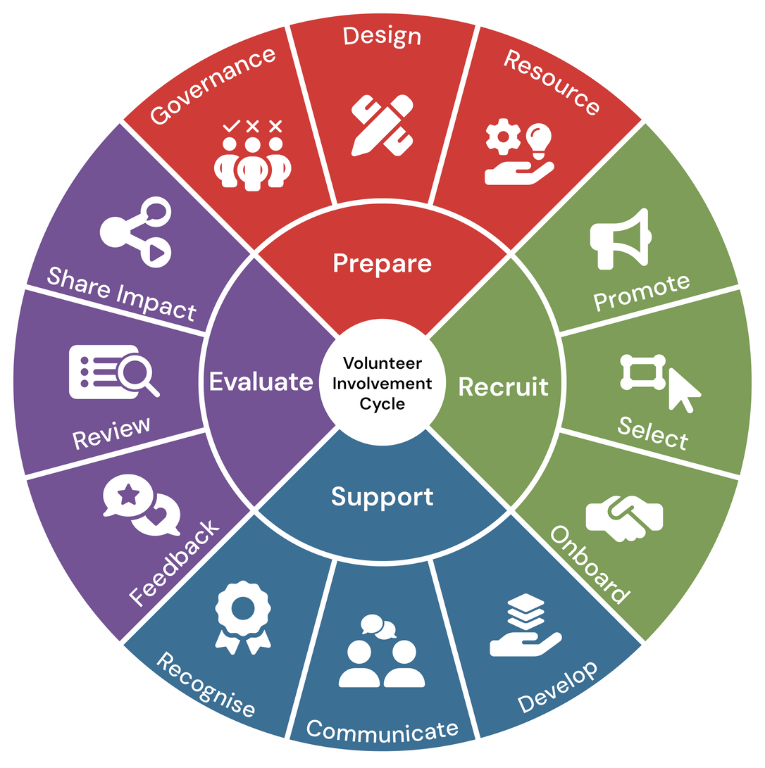

Module 3:
Support
Volunteer Involving Organisations:
Volunteer Involvement Cycle Review Workshop

Slide 2





Facilitation
The training can be completed with a facilitator in 3x 2 hour sessions. As there are a number of data sets that need to be gathered- preparation is key to utilise the full benefit of these workshops
Resource
Instructions
Independant
The resouce can be utilised independantly at your own pace.
Resources
All resources relating to this review module can be found under this section of the Module Webpage and should be downloaded and reviewed before beginning each module.
Help
Should you require help please contact us at Info@seniors.org.au

Slide 3
Introduction &
Objectives

Slide 4
Welcome
Whether you’re new to volunteer coordination or have years of experience, this session is designed to support you in strengthening your organisation’s approach to supporting volunteers.
We’ll be focusing on the Support stage of the Volunteer Involvement Lifecycle, which includes three key areas:
  Recognise – how you acknowledge and celebrate volunteer contributions
  Communicate – how you keep volunteers informed, engaged, and heard
  Develop – how you support volunteer learning, growth, and leadership
The aim of the module is to help you review your current practices, identify opportunities for improvement, and explore ways to streamline and automate your processes. We’ll be looking at each area from an organisational review perspective, and you’ll leave with practical strategies, tools, and templates you can apply immediately.
This training is aligned with the National Standards for Volunteer Involvement, and supports best practice in volunteer management. We encourage you to ask questions, share your experiences, and reflect on how these strategies can be tailored to your organisation’s unique context.

Slide 5


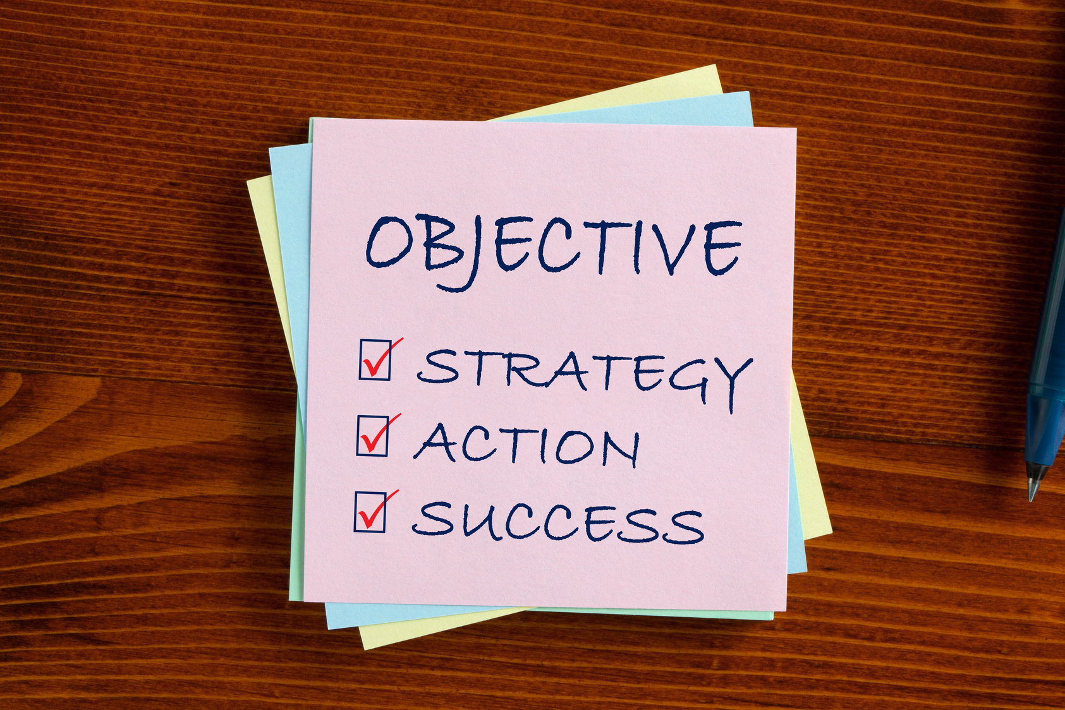
Objectives
Recognise the importance of volunteer support
  Building strong, sustainable volunteer programs, focusing on the areas of recognition, communication, and development.
Assess current organisational practices
  Gathering information on how volunteers are currently recognised, communicated with, and supported in their development.
  Identify opportunities for improvement in each area, using practical strategies that enhance volunteer satisfaction, motivation, and retention.
Explore ways to streamline support processes
  Including the use of digital tools, automation, and simplified procedures to reduce administrative burden and improve consistency.
  Incorporate creative and engaging enhancements that make volunteers feel valued, connected, and empowered in their roles.
Develop a tailored action plan
  Implement improvements in their organisation, with clear steps, responsibilities, and timelines.

Slide 6
Support: Recognise
In this section, we’ll explore how your organisation acknowledges and celebrates the contributions of volunteers. Recognition plays a vital role in volunteer satisfaction and retention. You’ll review your current recognition practices, reflect on their impact, and discover ways to improve, streamline, and creatively enhance how you show appreciation.
For this section, you will need to gather the first data set. You can use the Excel spreadsheet provided or employ your own method to capture the mentioned data set for the Recognise section of the review.

Slide 7



Information Gathering
  What recognition practices currently exist?
    Formal (awards, certificates)
    Informal (thank-you notes, shout-outs)
    How were these decided on?
  Frequency and consistency of recognition: Recognition may vary widely across teams or programs. Understanding how often and how consistently recognition is given helps identify gaps and opportunities for improvement.
  Who is responsible for recognition?
Notes:
[Pause for a moment and engage with the audience as you begin.]
Let's delve into the crucial step of identifying who oversees and makes decisions about our volunteers.
[Emphasize the importance of this point.]
Knowing who holds responsibility ensures accountability and smooth operations.
Next, in the Excel spreadsheet we've provided, you'll find a comprehensive list of all current policies and procedures related to volunteer involvement.
[Guide them to think actively.]
Take a moment to review these documents, and you'll notice that each one includes a link for easy access. This will help you understand how well these policies are working for us.
Another key task is documenting how volunteer roles align with our organisation's mission. This alignment is vital because it ensures that everyone is moving in the same direction and contributing to our overarching goals.
[Pause briefly to let this information sink in.]
By gathering this information, we're laying the groundwork for effective volunteer management, ensuring clarity and purpose in all we do.
[Encourage reflection with a gentle prompt.]
As we move forward, consider how this structured approach will aid in identifying any gaps or areas for improvement.

Slide 8
Information Review
Now that you have mapped out your current recognition , its time to review using the below as a guide along with the resource aids provided for this section:
  Are recognition efforts aligned with volunteer motivations?
  Is recognition inclusive and culturally appropriate?
  How is impact of Recognition measured?
  Is there any current feedback from staff and Volunteers on the effectiveness of recognition efforts?
Notes:
Let's take a closer look at our governance documentation. [Pause for a moment to engage the audience.]
Firstly, we need to assess whether there are any gaps in our current governance documentation. This means checking if we have all the necessary policies and procedures in place, and whether they are up-to-date and comprehensive. [Pause here to let the point resonate.]
Secondly, it’s crucial that these policies are easy for our volunteers to understand and follow. We must ensure they’re accessible, not just physically but also in terms of clarity and relevance. This is vital for fostering an inclusive and effective volunteering environment. [Emphasize the importance of accessibility.]
Finally, consider how we identify volunteer needs. Is there a systematic approach in place, and does it effectively capture the diverse needs of our volunteer team? An effective needs identification process is key to supporting our volunteers and aligning their roles with our organizational mission. [Pause briefly to allow the audience to reflect.]
These are the areas we need to focus on during our information review. It’s about ensuring our governance framework is robust, clear, and truly supportive of our volunteer efforts. [Conclude with a confident tone.]

Slide 9
Quality Improvement Strategies: Recognise
The following slides provide examples of strategic improvement steps that can be taken to support your programs.
We also encourage the use of the Volunteering Qld Library of resources as further support.

Slide 10

  QUALITY IMPROVEMENT STRATEGIES: RECOGNISE
Develop a recognition framework tied to values and impact
Include volunteer input in designing recognition programs
Create a calendar of recognition events
  Create a structured approach to volunteer recognition that aligns with your organisation’s core values and mission.
  This framework should define what types of contributions are celebrated (e.g., leadership, consistency, innovation) and how they connect to broader community outcomes.
  It ensures recognition is meaningful, equitable, and reinforces desired behaviours.
  Engage volunteers in co-designing recognition initiatives through surveys, focus groups, or informal feedback.
  This helps tailor programs to what volunteers find motivating and meaningful, increasing engagement and satisfaction.
  It also fosters a sense of ownership and inclusivity.
  Plan and publish a yearly calendar that includes key dates for volunteer appreciation—such as National Volunteer Week, birthdays, anniversaries, and themed appreciation days.
  This ensures consistent and timely recognition, helps with planning, and builds anticipation among volunteers.
  1
  2
  3

Slide 11
  QUALITY IMPROVEMENT STRATEGIES: STREAMLINING & AUTOMATION
Track Milestones
Automate Birthday/Anniversary Messages
Generate Reports for Recognition Eligibility
  Implement systems that automatically record volunteer hours, event participation, and key achievements.
  This allows coordinators to monitor progress without manual data entry, saving time and reducing errors.
  Milestone tracking helps identify when volunteers reach thresholds for recognition (e.g., 100 hours of service, 1-year anniversary).
  Enables timely and meaningful acknowledgment, boosting morale and retention.
  Set up automated workflows to send personalised messages for birthdays, service anniversaries, or other special dates.
  These messages can be customised with names, roles, and milestones to feel personal despite being automated.
  Helps maintain a culture of appreciation and connection, especially in large or remote teams.
  Use built-in analytics to create reports that highlight top contributors, long-term volunteers, or those who’ve reached specific goals.
  These reports can be filtered by time period, activity type, or location to support targeted recognition efforts.
  1
  2
  3

Slide 12
Examples of CRM & Volunteer Management Tools
Strategy | Description
BetterImpact | Comprehensive volunteer lifecycle management | Volunteer scheduling, hour tracking, automated reminders, birthday recognition, branded forms, advanced reporting, mobile app, REST API
HubSpot for Nonprofits | Donor & volunteer engagement automation | Free CRM tier, customisable workflows, email automation
Golden | Real-time volunteer engagement | Check-ins, impact tracking, CRM integrations
Charityproud | Small to mid-size nonprofits | Volunteer & donor management, reporting
Get Connected | Volunteer shift scheduling & engagement | Self-serve portals, CRM sync, impact reports
Quality Improvement Strategy: Recognise

Slide 13





  QUALITY IMPROVEMENT STRATEGIES: CREATIVE ENHANCEMENTS
  Peer-to-peer recognition programs
  Recognition tokens (e.g., badges, digital awards)
  Empower volunteers to recognise each other through nomination systems, shout-out boards, or digital thanks. This builds community and shared appreciation.
  Gamify recognition with visual tokens that volunteers can collect or display. These can be tied to achievements, roles, or values.
  “Wall of Thanks” or digital appreciation boards
  Volunteer spotlight stories on social media
  Create a physical or online space where staff and volunteers can post messages of gratitude. It’s a simple yet powerful way to foster a culture of appreciation.
  Feature individual volunteers in posts or videos that highlight their journey, impact, and personality. It boosts morale and public awareness.

Slide 14
Example of Design of Recognition Gifts
Recognition gifts can be thoughtfully crafted to reflect the mission and values of the organisation, making them more meaningful and memorable. Rather than relying solely on generic items, consider creating tailored gifts that celebrate the unique identity of your organisation and community.
Strategy | Description
Leverage local talent: | Engage current volunteers or community contacts with creative skills—such as artists, crafters, or designers—to co-create gifts. A local artist might donate a custom painting that symbolises the organisation’s service or impact.
Partner with schools: | Collaborate with local schools to have students write thank-you poems, stories, or create artwork that expresses appreciation for the volunteers that work with the children or school. These can be replicated and framed for a specific milestone/s.
Involve service participants | Ask individuals who benefit from the organisation’s services to write personal thank-you cards or messages. These heartfelt notes can be replicated and shared as part of recognition packages.
Quality Improvement Strategy: Recognise

Slide 15
Support: Communicate
Effective communication is the foundation of strong volunteer relationships. This section focuses on how your organisation keeps volunteers informed, engaged, and heard. You’ll assess your current communication methods, identify gaps, and explore strategies to improve clarity, consistency, and connection—while also considering automation and creative approaches.
For this section, you will need to gather the second data set. You can use the Excel spreadsheet provided or employ your own method to capture the mentioned data set for the Design section of the review.

Slide 16
Information Gathering
  Gather information on what channels are used (email, SMS, social media, meetings)?
  Frequency and clarity of communication and who is responsible at each stage of communications.

Slide 17
Information Review
Now that you have mapped out your current communication information, it's time to review the current content using the below as a guide along with the resource aids provided for this section:
  Are volunteers receiving the information they need?
  Consider whether volunteers have access to clear instructions, schedules, role expectations, and updates.
  Are onboarding materials and event details easy to find and understand?
  Is communication timely and relevant?
  Evaluate if messages are sent with enough notice and tailored to the volunteer’s role or location. Are updates frequent enough to keep volunteers informed but not overwhelmed?
  Are there gaps in communication across teams?
  Identify if certain groups (e.g. remote volunteers, team leaders, new recruits) are missing out on key information. Are there inconsistencies in how messages are delivered across different platforms or teams?

Slide 18
Quality Improvement Strategies: Communicate
The following slides provide examples of strategic improvement steps that can be taken to support your programs.
We also encourage the use of the Volunteering Qld Library of resources as further support.

Slide 19
  QUALITY IMPROVEMENT STRATEGIES: COMMUNICATE
Develop a communication plan tailored to volunteer roles
Include feedback loops (surveys, suggestion
Use Multiple Formats to Increase Accessibility
  Create role-specific communication strategies that outline what information is shared, how often, and through which channels.
  Ensure messages are relevant to each volunteer’s responsibilities
  Ensure volunteers know who to contact for questions, support, or escalation.
  Assign communication leads or coordinators for different teams or roles to streamline information flow.
  Regularly collect input from volunteers through anonymous surveys, digital suggestion boxes, or informal check-ins.
  Use this feedback to refine communication practices and address concerns.
  Recognise and Respond to Feedback Publicly
  Show volunteers that their input leads to action.
  Deliver messages in various formats—email, SMS, printed handouts, video, or translated materials—to accommodate different preferences and accessibility needs.
  Review communication channels, frequency, and content to identify gaps or redundancies.
  Use volunteer feedback and engagement data to assess effectiveness and make improvements.
  1
  2
  3

Slide 20
  QUALITY IMPROVEMENT STRATEGIES: COMMUNICATE
Use Communication Platforms (e.g., Mailchimp, Slack, WhatsApp groups)
Set Up Auto-Responses for Common Inquiries
Use Scheduling Tools for Volunteer Shifts
  Choose tools that suit your team’s size and tech comfort level.
  Mailchimp is ideal for newsletters; Slack supports team collaboration; WhatsApp is great for quick updates and group chats.
  Develop reusable templates for onboarding emails, event reminders, thank-you notes, and emergency alerts.
  Monitor open rates, click-throughs, and response times to evaluate communication effectiveness.
  Use email or form-based auto-replies to acknowledge volunteer queries and provide links to FAQs or resources.
  This helps manage expectations and ensures timely responses.
  Connect your volunteer management system-If used- (e.g., BetterImpact, Golden) with email platforms to personalise messages based on volunteer data (e.g., role, location, milestones).
  Automate shift reminders and confirmations using tools like SignUpGenius or Rosterfy. This reduces manual coordination and improves attendance rates.
  Allow volunteers to update their contact info, view schedules, and access resources through a secure portal. This reduces admin workload and empowers volunteers.
  1
  2
  3

Slide 21
Example of Creative Enhancements
Strategy | Description
Volunteer-led communication committees | Empower volunteers to co-design and manage communication efforts. This fosters ownership and ensures messages reflect volunteer perspectives.
Interactive dashboards or portals | Use online platforms where volunteers can log hours, view schedules, access resources, and receive updates. Dashboards promote transparency and self-service.
Video updates from leadership | Share short video messages from coordinators or executives to build connection and trust. Videos can highlight achievements, share news, or express appreciation.
Storytelling campaigns featuring volunteers | Showcase volunteer stories through blogs, social media, or newsletters. This builds community, celebrates contributions, and inspires others to get involved.
Quality Improvement Strategy: Communicate

Slide 22
How Communication differs across Generations
Strategy | Preferred Methods: | Description
Baby Boomers (born 1946-1964) | Calls, and written correspondence. | Style: Formal, valuing directness and clarity. Considerations: Appreciate personal interaction and traditional communication forms. Examples: Sending a handwritten thank-you note after a meeting or scheduling a face-to-face catch-up over coffee.
Generation X (born 1965-1980) | Emails, phone calls, and in-person meetings. | Style: Practical and straightforward. Considerations: Comfortable with both traditional and digital communication. Examples: Sending a detailed email with bullet points or having a quick phone call to discuss project updates.
Millennials (born 1981-1996) | Instant messaging. | Style: Informal and collaborative. Considerations: Favour digital communication and participatory decision-making. Examples: Using a group chat for team collaboration or sharing updates via social media.
Generation Z (born after 1997) | Video calls. | Style: Fast-paced and visual. Considerations: Expect rapid responses and use multiple platforms. Examples: Using Instagram stories for quick updates or hosting a video call for a team meeting
Quality Improvement Strategy: Communicate

Slide 23
Support: Develop
This stage focuses on nurturing volunteers through ongoing guidance, recognition, and opportunities for growth.
By providing clear communication, training, and meaningful feedback, we help volunteers feel valued and empowered to expand their skills and contributions.

Slide 24
Information Gathering
  On the Spreadsheet provided list all current training including onboarding modules, role-specific inductions, and occasional workshops.
  How training is facilitated/presented?
  Who is responsible for training and ongoing volunteer upskilling?
  Map out the training Calendar.

Slide 25
Information Review
Now that you have mapped out your current role training and program information, it's time to review the current content using the below as a guide along with the resource aids provided for this section:
Accessibility and Inclusivity
  Are training sessions scheduled flexibly? Are materials available in multiple formats (e.g. online, print, multilingual)? Do they accommodate diverse learning styles and abilities?
Progression and Leadership Pathways
  Is there a clear route for volunteers to take on more responsibility or leadership roles? Are these pathways communicated and supported through mentoring or training?
  Do volunteers feel they are acquiring new skills, gaining confidence, and becoming more effective in their roles? Are they encouraged to reflect on their development?
Tracking Learning Outcomes
  Are learning outcomes defined and measured? Is there a system to record completed training, assess impact, and identify areas for improvement?

Slide 26
Quality Improvement Strategies: Develop
The following slides provide examples of strategic improvement steps that can be taken to support your programs.
We also encourage the use of the Volunteering Qld Library of resources as further support.

Slide 27
Quality Improvement Strategy: Communicate
Strategy | Description
Volunteer Development Framework | Develop a structured framework outlining core competencies, training pathways, and progression options. This ensures consistency and clarity across the organisation. Define key skills and knowledge areas for each role Map out training stages and progression routes Align development with organisational goals and volunteer motivations Ensure the framework is adaptable to different volunteer contexts
Tiered Learning Opportunities | Offer training at multiple levels—beginner, intermediate, and advanced—to cater to varying experience levels and encourage continuous growth. Provide entry-level orientation and foundational skills Introduce intermediate modules for skill enhancement Offer advanced training for leadership and specialised roles Allow volunteers to self-select or be guided based on experience
Soft Skills and Leadership Training | Include modules on communication, teamwork, emotional intelligence, and leadership to prepare volunteers for more complex roles and enhance overall effectiveness. Build interpersonal and conflict resolution skills Encourage reflective practice and self-awareness Develop leadership capabilities for team coordination Support succession planning and internal promotion

Slide 28
Quality Improvement Strategy: Streamlining & Automation
Strategy | Description
Learning Management Systems (LMS) | Implement an LMS to host training modules, track progress, and provide easy access to resources. This centralises learning and improves scalability. Enable self-paced learning and remote access Integrate multimedia content for diverse learning styles Provide dashboards for volunteers and coordinators Ensure data security and user-friendly navigation
Automated Reminders | Use automated systems to send reminders for mandatory training, refreshers, or upcoming workshops, reducing administrative burden. Schedule recurring notifications for compliance deadlines Customise reminders based on volunteer roles Reduce missed training sessions and improve completion rates
Digital Tracking | Monitor training completion, progress, and outcomes . Identify gaps and tailor future training Link learning outcomes to volunteer impact

Slide 29
  QUALITY IMPROVEMENT STRATEGIES: CREATIVE ENHANCEMENTS
  Microlearning via Mobile Apps, PPT, Toolbox Talks or EDM
  Co-Designed Workshops
  Involve volunteers in designing and delivering training sessions to ensure relevance, ownership, and shared expertise.
  Tap into volunteer knowledge and lived experience
  Foster collaboration and empowerment
  Ensure training reflects real challenges and needs
  Build a culture of continuous learning and innovation
  Deliver bite-sized learning content through mobile platforms to increase accessibility and engagement, especially for time-poor volunteers.
  Use short videos, quizzes, and infographics
  Allow learning on-the-go and in downtime
  Reinforce key concepts through repetition
  Track engagement and completion metrics
  Volunteer Mentorship Programs
  Gamified Learning Experiences
  Pair experienced volunteers with newcomers to foster peer learning, build community, and support informal development.
  Encourage knowledge sharing and role modelling
  Support onboarding and confidence building
  Strengthen relationships and retention
  Recognise mentors for their contribution
  Introduce elements like badges, points, and challenges to make learning fun and motivating.
  Reward progress and participation
  Create friendly competition and team challenges
  Increase engagement with interactive content
  Link achievements to real-world impact

Slide 30
Congratulations on completing Module 3: Support
In this module, we focused on the first stage of the volunteer journey—Support, which included:
  Understanding the importance of creating a welcoming and inclusive environment for volunteers
  Exploring strategies to provide emotional, practical, and peer support
  Reviewing tools and systems that help volunteers feel connected and valued
  Identifying ways to respond to challenges and feedback effectively
  Highlighting the role of coordinators and team leaders in sustaining volunteer wellbeing
What’s next?
  Future modules will build on this foundation, covering recruitment, onboarding, engagement, and recognition strategies.
Would you like a personalised walkthrough of the full VIO Training Module Series?
  📧 Email us at: Info@seniors.org.au to arrange a session with a Volunteering Queensland team member.

Slide 31


Resource
Links
NSVI Evidence Guide
Checklist for Volunteer Leaders- NSVI Gap Assessment
Gap Analysis Excel
Induction and Onboarding for new Volunteers- Guide

